Slide 1
DIT4299 Software Development Project Group Project for Travel and Tourism Promotion ICT Project Travel app: fun trip
Fok Tsz Ching 220134800
Luo Jian Chang 230314716

Slide 2
CONTENTS
Overview
Key Problem
Competitor App
Solution
Goal
Sketch and Storyboard
Prototype Preview
Demo

Slide 3
Project Overview
Over 34 million tourists in 2023
After COVID-19, people want safe, relaxing, and new travel experiences
Our goal: Build a travel app that makes planning easy, fun, and stress-free

Slide 4
Key Problems
Too many choices
Hard to plan trips

Slide 5
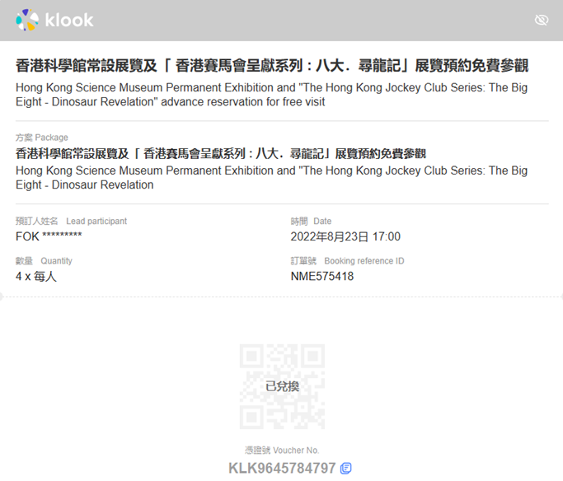
Competitor Apps: Klook
Cannot easily add this activity into schedule

Slide 6
Our Solution
Personalized trip planning
Smart daily schedule builder
Real-time AR navigation
Points and coupon reward system

Slide 7
OUR GOALS
Make travel planning easy
Create a comfortable and personalized experience
Include smart tools to improve the trip

Slide 8
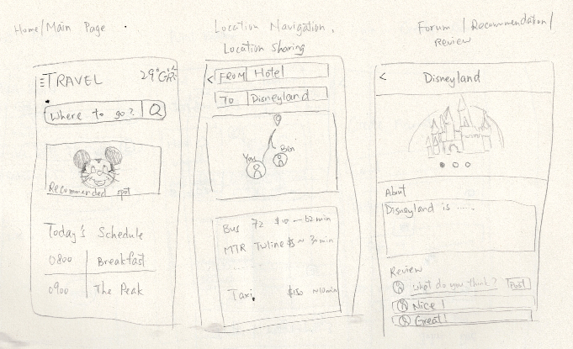
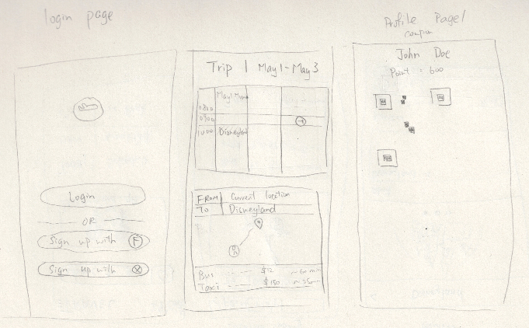
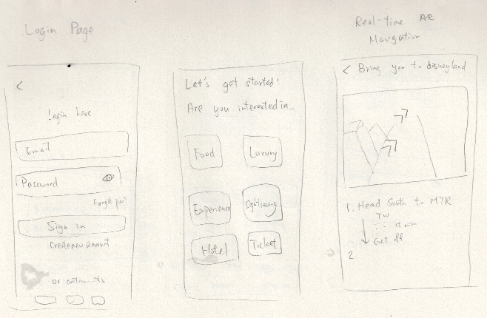
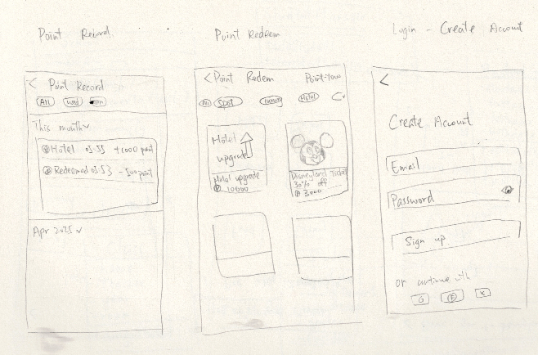
SketcH

Slide 9
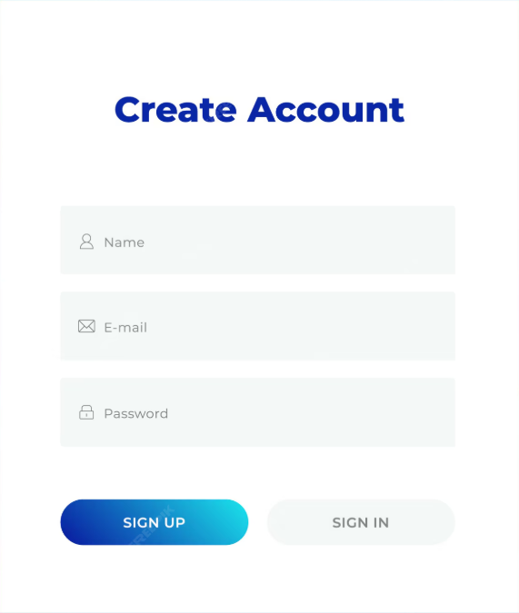
STORYBOARD – STEP BY STEP JOURNEY
User Account Creation
Set Travel Preferences

Slide 10
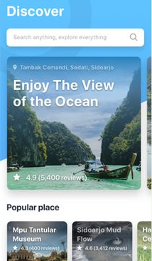
STORYBOARD – STEP BY STEP JOURNEY
Explore Recommendations
Plan the Trip

Slide 11
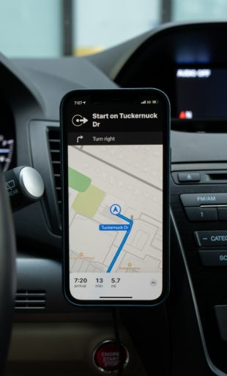
STORYBOARD – STEP BY STEP JOURNEY
Use Navigation

Slide 12

STORYBOARD – STEP BY STEP JOURNEY
Earn Rewards
Review and share experience

Slide 13
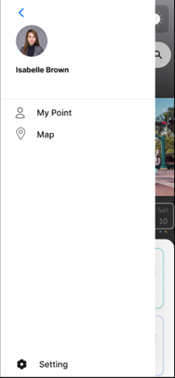
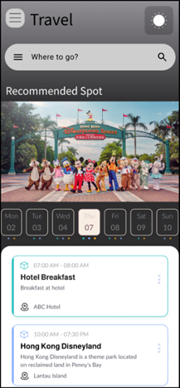
Prototype
Sidebar Menu
Home Page

Slide 14
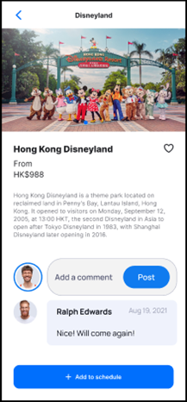
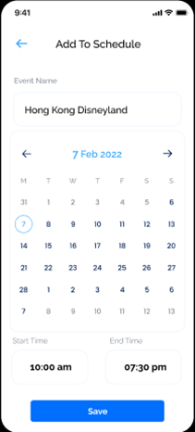
Prototype
Spots Detail Page
Add to Schedule Page

Slide 15
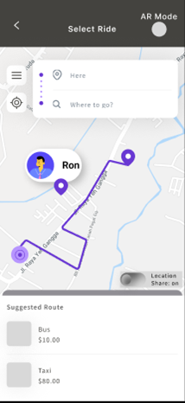
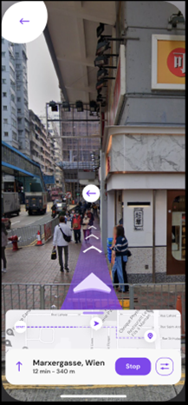
Prototype
Map Navigation Page
AR Navigation Page

Slide 16
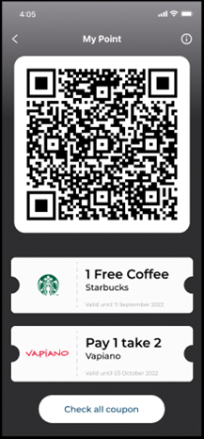
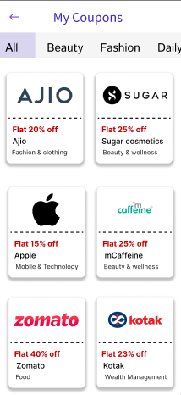
Prototype
My Points Page
Coupon Gallery Page

Slide 17
THANK YOU
Figma:
https://www.figma.com/proto/3NkEXY0VkGKQcs3CIru51u/Lab2?node-id=19-42&t=EzBsVooa3meByrkX-1&scaling=min-zoom&content-scaling=fixed&page-id=8%3A976&starting-point-node-id=19%3A42&show-proto-sidebar=1

